Slide 1
FRANKENSTEIN
Author: Mary Shelly

Slide 2
IN YOUR NOTEBOOKS
WHO OR WHAT IS FRANKENSTEIN?

Slide 3
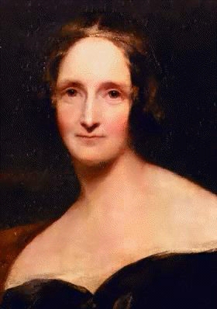
Mary Shelly
1797-1851
English Novelist
Author of Frankenstein

Slide 4
Frankenstein
Gothic fiction/horror: combines Horror and Romanticism.
Romanticism:
Imagination is greater than reason
emotion
freedom from rules
importance of the individual
Love and devotion to nature

Slide 5
INTERESTING FACTS
One of the first science fiction (Sci-fi) books
Inspired by electrical experiments done on animals at the time called GALVANISM

Slide 6
Galvanism
Contraction of muscle simulated by electricity.

Slide 7
Fishbowl!
INSTRUCTIONS: Move the desks in a large circle around the classroom, and put 4 desks in the middle of the large circle.
Take out notebooks and a pen/pencil

Slide 8
1.) It is a parent’s job, more than society’s, to nurture his/her child.

Slide 9
2.) With the advent of genetic engineering and “designer” babies, parents now have less important roles in the birth process.

Slide 10
3.) All children are innately good.

Slide 11
4.) Every child needs “mothering” in order to become “human.”

Slide 12
5.) All parents love their children unconditionally, no matter how they look or act.

Slide 13
6.) Children who are “deformed” physically or mentally should be isolated from society.

