Slide 1
Perspective in story telling: Class Activity
4 people per group: Look at the picture and start writing a short story about it from the perspective of one of the people in the picture. Put the number of the person you chose on your paper. What is happening before/during/and after that photo?
After 5 minutes, rotate your stories in your group, where you will continue each others’ stories.

Slide 2
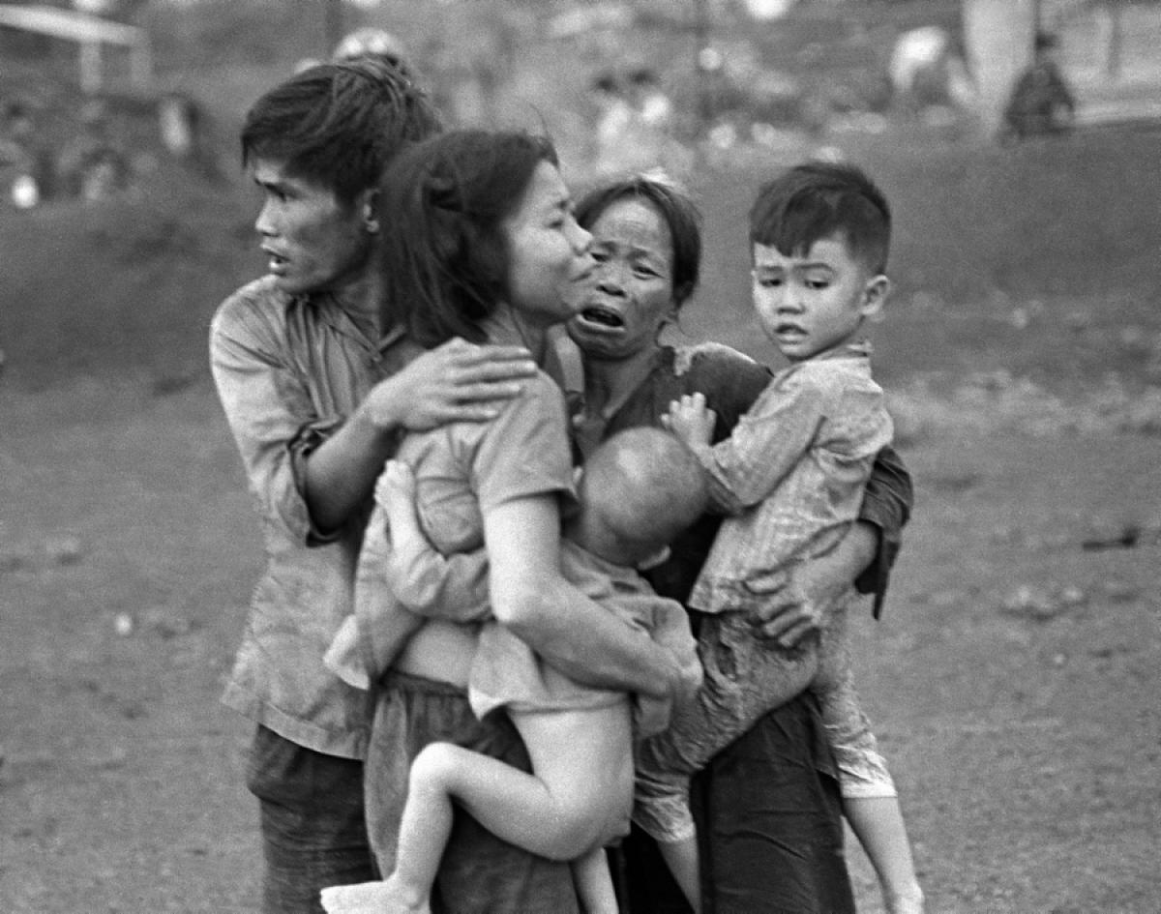
1
3
2
4

