Slide 1
SYMBOLISM

Slide 2
WHAT IS SYMBOLISM?
Giving meaning to certain objects or ideas
Using symbols to represent ideas or qualities.

Slide 3
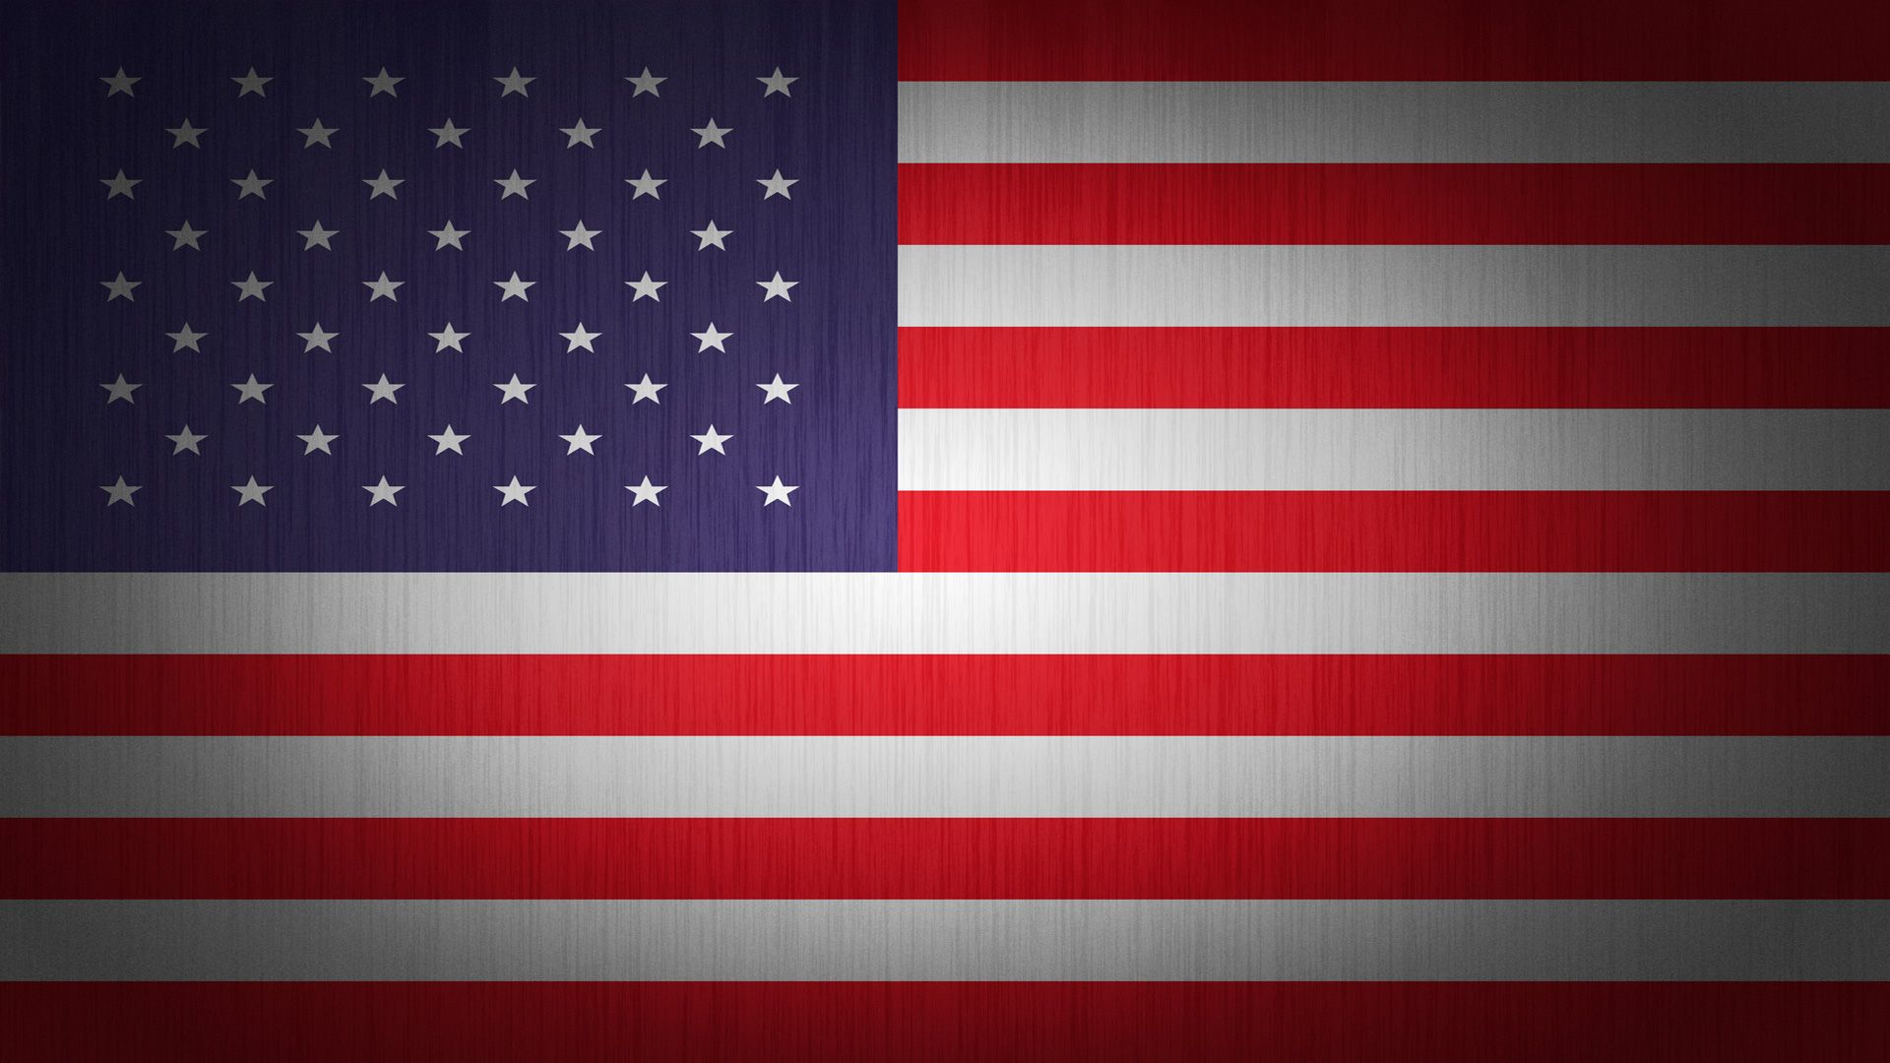

Slide 4
AMERICAN FLAG
This could symbolize freedom, patriotic feeling, equality, and democracy… OR it could symbolize greed, capitalism, and corruption.

Slide 5
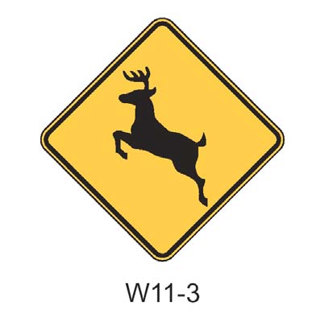

Slide 6
DEER CROSSING
Symbolizes the idea that drivers must be aware of crossing dear so as not to run them over if a dear chooses to cross the road.

Slide 8
BIOHAZARD SYMBOL
Symbolizes a hazard or to be cautious of chemicals; used as a warning

Slide 10
RED HEXAGON
Symbolizes to stop before proceeding

Slide 11
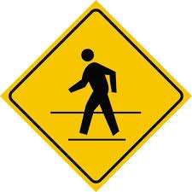

Slide 12
PEDESTRIAN CROSSING SYMBOL
Symbolizes the idea that a driver must be aware of pedestrians walking so as not to run them over when a pedestrian chooses to do so.

Slide 13
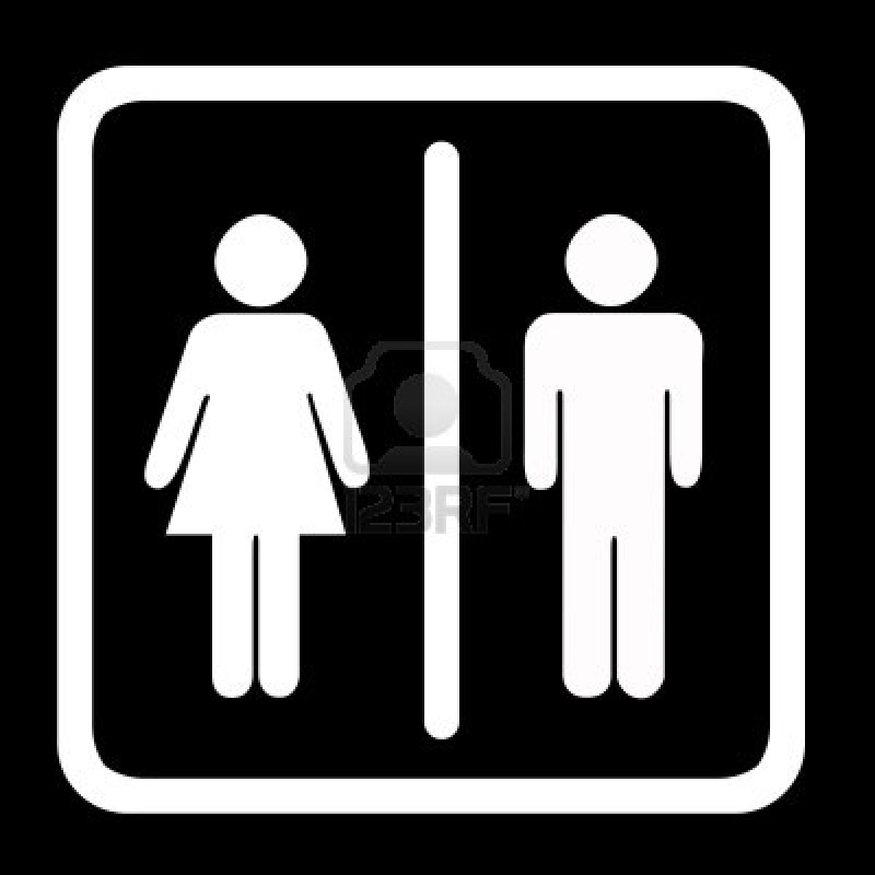

Slide 14
WOMEN’S/MEN’S SYMBOL
Symbolizes women and men’s bathroom

Slide 16
HANDICAP SYMBOL
Symbolizes the idea of selective parking. If you are not handicapped, you may not park in spots that are close to an entrance.

Slide 18
PEACE SYMBOL
Symbolizes peace/anti war

Slide 20
BREAST CANCER PINK RIBBON SYMBOL
Symbolizes breast cancer awareness/moral support

Slide 21
COLORS
Black symbolizes mourning
White symbolizes purity

Slide 22
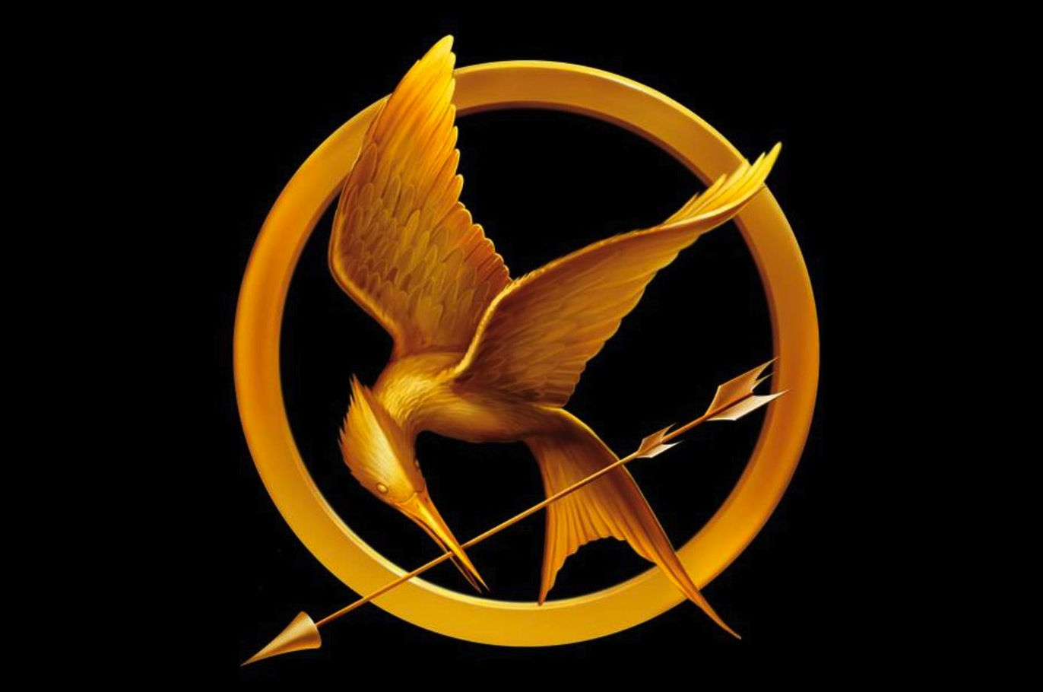
In The Hunger Games
Mocking jays symbolize what?

Slide 23
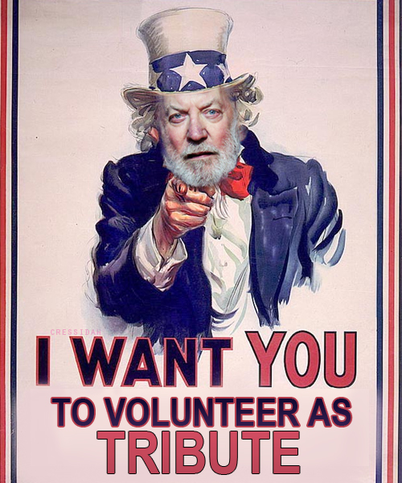
In The Hunger Games
The Annual Hunger Games symbolizes what?

Slide 24
What does Martin Luther King Jr. Symbolize?
Peace, Equality, Freedom, and Leadership

Slide 25
SURPRISE QUESTION!!!
What did speakeasies symbolize?
MARIAH

Slide 26
WHAT’S THE PRIZE?
2 EXTRA CREDIT POINTS

Slide 27
This is a symbol for recycling. This symbol shows green arrows going/pointing around in a cycle. It represents the cycle of reusing materials to save resources. Personally, this to me symbolizes the fight against waste or being wasteful. This symbolizes a hope for a cleaner planet Earth.

Slide 28
IN YOUR NOTEBOOKS
Pick any symbol (cultural, religious, or national symbol) Write one paragraph analyzing it’s meaning just like I did with the recycle symbol. Analyze its standard meaning and then make a personal interpretation. What does that symbol mean to you?

