Slide 1
What is perspective?
Take a look at the following pictures.
Write these questions down on your sheet of paper:
1.) What you see
2.) What you think is happening
3.) Which perspective the pictures take on.
4.) How it makes you feel

Slide 2
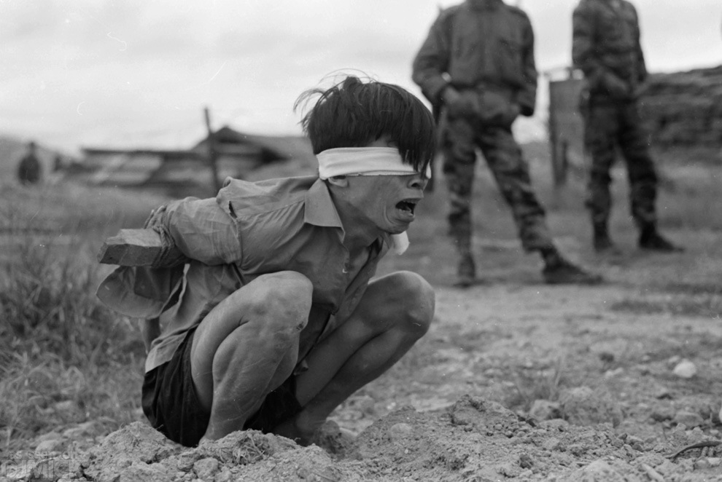

Slide 3
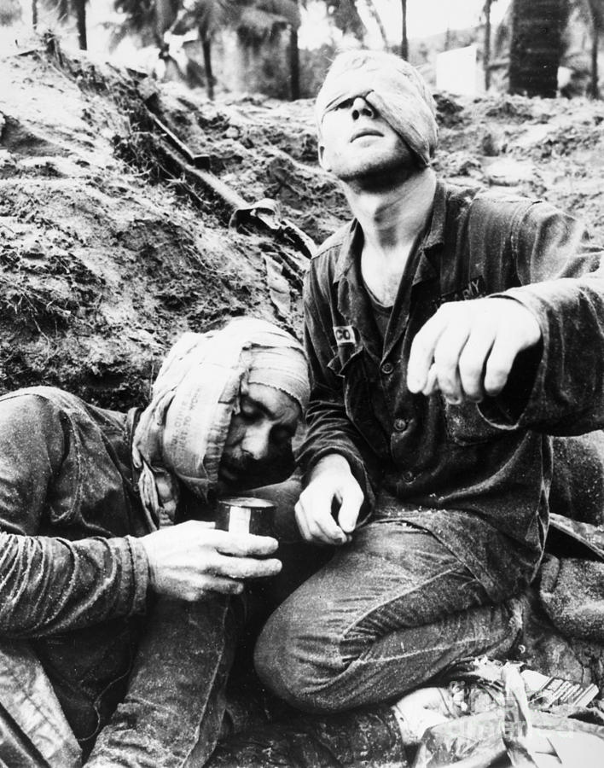

Slide 4
