Slide 1
“LORD OF THE FLIES”
BY WILLIAM GOLDING

Slide 2
“Lord of the Flies”
1954 DYSTOPIAN NOVEL WRITTEN BY NOBEL PRIZE WINNER WILLIAM GOLDING
DYSTOPIAN NOVEL: genres of literature that explore social and political structures. Creation of a horrible or degraded society.
Examples: “The Hunger Games” and “Divergent”

Slide 3
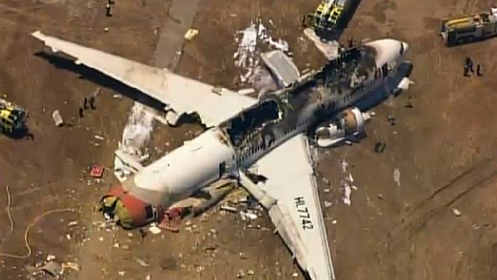
YOU ARE ALL ON A PLANE WHEN SUDDENLY…
THE PLANE CRASHES ON AN ISLAND

Slide 4
BUT ALL OF YOU SURIVE…
MAKE A LIST OF THE FIRST 5 MOST IMPORTANT THINGS TO DO

Slide 5
BUT ALL OF YOU SURIVE…
MAKE A LIST OF THE FIRST 5 MOST IMPORTANT THINGS TO DO

Slide 6
YOU WILL NEED A LEADER
WHAT DOES IT TAKE TO BE A LEADER?
HOW DO YOU DECIDE WHO WILL BE YOUR LEADER?
NOMINATE A CLASS MEMBER TO BE THE LEADER BASED ON THOSE ATTRIBUTES

Slide 7
BELL RINGER
What are rules? Why do you think we create rules?

Slide 8
AND THE APPOINTED LEADER IS…

Slide 9
IT IS TIME TO CREATE YOUR RULES
Come up with 10 rules that you will all follow on the island, as well as the consequences for each rule if someone breaks the rules.
What are some things that can happen when a group of people try to create rules?

Slide 10
DESIGNATE JOBS
Create a system amongst you all.
What jobs need to be done? Who will do these jobs?
How do you make sure everyone will do their job?

Slide 11
CREATE SHELTER
It rains a lot on this island, therefore you must create shelters that will endure storms. What materials will you use? Draw a picture of the shelter.

