Slide 1
BEAUTY
THEN AND NOW

Slide 2
What is Beauty?

Slide 3
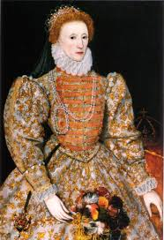
In Shakespeare’s Time…
Elizabethan Era: 1558-1603 When Queen Elizabeth ruled!
Golden Era: poetry, music, literature, and theatre

Slide 4
Queen Elizabeth I was the ideal beauty that every woman wanted to look like.

Slide 5
SURPRISE QUESTION!!!
MUFID
NAME 2 BEAUTY TRENDS OF
THE ELIZABETHAN ERA

Slide 6
WHAT’S THE PRIZE?
1 EXTRA CREDIT POINT!

Slide 7
Beauty in Shakespeare’s Time
A high hair line
Red lips and cheeks
Pale skin
Arched eyebrows
Fair hair

Slide 8
ANSWER IN YOUR NOTEBOOKS
Are there any beauty trends that we see in today’s society that was also used in the Elizabethan Era? If so, what are they?

Slide 9
Beauty Now

Slide 10
Beauty Now
Make a list of beauty trends in our society now!

Slide 11
Beauty in our society today
Long hair
Tans
Make up (like the Kardashians)
Skinny

Slide 12
ANSWER IN YOUR NOTEBOOKS
What does it mean to be beautiful or perfect in our society today?
How important is being beautiful in today’s society?
Do you think being perfect is realistic?

Slide 13
Watch this…
http://www.youtube.com/watch?v=iYhCn0jf46U
http://www.youtube.com/watch?v=-_I17cK1ltY

Slide 14
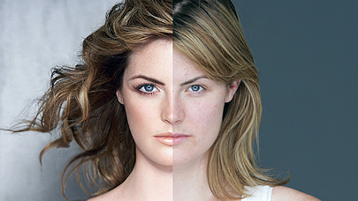
Things aren’t always as they appear..

